Slide 1
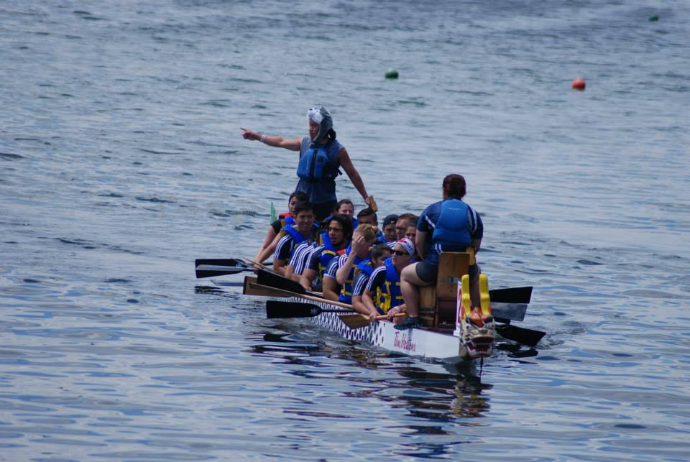
How To Train Your Dragon Boat
Team Members:
Giuseppe Ragusa: Scrum Master
Andrew B. Cobb: Head Programmer
Arsalan Farooqui: Project Manager

Slide 2
Description
Mobile Application
Allows for
team management
layout simulations
Viewing performance analytics
Features include:
GPS tracking
Automated calculations for boat balancing
iOS and Android Support
Notes:
Arsalan

Slide 3
Project Vision
Issues:
Balancing Dragon Boats Manually is an inefficient task
Traditional method of measuring performance is Ineffective
No centralized platform for managing team information
Solution:
How To Train Your Dragon Boat App!
Notes:
Arsalan

Slide 4
High Level Requirements
Information Flows | Description
Create teams | Manger selects who will be on the team
Balances boat | App reports the position of team members to the boat is balanced
Start Race | Crew signifies start of race
Report performance | Live report of current speed and position
Team Statistics | App reports speed vs time graph and show route of boat after race
Notes:
Andrew

Slide 5
Project Plan : Deliverables
Deliverables
An Interactive GUI displaying team members and available positions on the boat layout
A Tab providing details on the current boat layout as the members are being assigned
An option to save the current layout and to load previously saved layouts
A tab displaying information regarding the boat’s performance
The ability to save the current route the boat recently took, and load previous routes.
Notes:
Andrew

Slide 6
Project Plan: Scope
In Scope
Features designed for use as a Mobile Application
Efficient method of team management when assigning boat layouts with layout information
Map providing the location of the boat.
Information about the boat’s performance during races.
Compatibility with other mobile related platforms including tablet.
Not in Scope
Other platform functionality beyond Mobile
Setting custom paths for boat routes
Location Finding using the map interface

Slide 7
Team Charter
Team Roles
Arsalan Farooqui - Project Manager, in charge of over all project vision, detailing requirements and working with the GBC Dragon Boat Team to analysis needs.
Giuseppe Ragusa - Scrum Master, in charge of keeping track of progress of the team, setting short term goals and making sure sprints are completed on time
Andrew B. Cobb - Head Programmer, in charge of application design and implementation, ensuring coding standards are maintained
Empowerment
Team members responsible for tasks
Co –operation to ensure sprint goals are met
Operations
unanimous decisions
Using GitHub repository
Performance Assessment
Milestone
Setting sprint goals
Notes:
Joey

Slide 8
Tasks
Sprint 1 Tasks – Est. 6-7 days
Database Design and Schema
UML Diagrams
Design in App Navigation Structure
Designing Application Screen Wireframes
Sprint 2 Tasks – Est. 6-7 days
Studying Further on Node.js
Leaning React and React Native Library
Sprint 3 Tasks – Est. 7 days
Designing and Creating Database
Creating Folder Heirarchy
Create Models and Class Structures
Implement Basic Navigation Structure
Test Navigation
Sprint 4 Tasks – Est. 4-5 days
Create Home Screen
Create Layout Screen
Create Boat Layout Screen
Test Layout Screen
Notes:
Joey

Slide 9
Tasks Continued
Sprint 5 Tasks – Est. 6-7 days
Implement Boat Layout
Test Boat Layout
Create People Screen
Create Add Person Screen
Test Person Screen
Sprint 6 Tasks – Est. 6-7 days
Create Ready Screen
Implement Google Maps API
Implement Stop Watch
Implement Creating Graphs
Test Ready Screen
Sprint 7 Tasks – Est. 3-4 days
Create Analytics Screen
Implement Viewing Graphs
Test Analytics Screen

Slide 10
Questions?
Finnish
Thankyou for your time
any

